Slide 1
M.A.P.H.S. 1st General Meeting
January 23rd, 2012
430pm-530pm
WHITE OAK ROOM SCE

Slide 2
WELCOME BACK!
SPRING SEMESTER 2012

Slide 3
Our E-Board
President: Samra Mahdi
Vice President: Allan Ho
Treasurer: Soo Ko
Secretary: Huong Le
Public Relations Officer: Aprille Banchoencharoensuk
Volunteer Coordinators: Jaimie Del Rosario and Jasmine Hill
MAPHS Liaison: Steven Le

Slide 4
Newbies!
Print out the application, fill it out and turn it in at the end of the meeting
Fees: $10 ($15 after February 6th, 2012)
Must attend 4+ meetings
Volunteer at 3+ events
Attend 1+ Bake Sales

Slide 5
Oldies!
Fees: $10 (each semester) DUE: February 6th, 2012
Check with Huong on your member status (she has a spreadsheet with all the events you’ve attended—emailed at the end of last semester)
If you DID NOT pick up your shirt last semester, they will be at the next meeting

Slide 6
Check out our websites!!
  http://uicmaphs.weebly.com/
    Check out the site for upcoming event dates, requirements, minutes, etc.
  http://www.facebook.com/group.php?gid=19857385871
    Join our Facebook group if you haven’t already done so by searching: “MAPS [Minority Association of Pre-Health Students] @UIC
Notes:
uicmaphs.weebly.com site:
Check out the site for upcoming events, due dates, requirements, event dates and times, meeting times and rooms, minutes, etc.
Twitter site:
Anyone who has a twitter, follow us so that you are up-to-date on events and times, especially if anything changes, instead of looking at your emails you can get a tweet to your cell phone
Collegiate link site:
Our UIC org site
Facebook group:
Join our fb site by searching MAPS [Minority Association of Pre-Health Students] @UIC

Slide 7
Websites Continued
  http://twitter.com/uicmaphs
    Follow us on twitter, get up to date info, alerts you where the meetings are, what we will talk about and facts of the day
  https://uic.collegiatelink.net/organization/minorityassociationofprehealthstudents
    Our UIC org website, has the main roster, and a way where you can email the group

Slide 8
Upcoming Events
Good Knight Rape Awareness-Audition!
Shamrock Shuffle-TBA
Bake Sale
Meetings/Speakers
Food Drive!

Slide 9
Good Knight Rape Awareness
Hosted by OBDC and NLVS
Good Knight is a Man Pageant and Variety show to help raise awareness and funds for rape victims.
Auditions for Good Knight start TOMORROW Tuesday, January 24th 5-7pm in the Cardinal Room and/or THIS FRIDAY, January 27th, 5-7PM Room 610 of SCE
You GUYS should tryout! It’s for a good cause and it’s a way to showcase your talent! The Good Knight Auditions page will be posted on our Facebook page for those of you who want to tryout!!

Slide 10
Good Knight Rape Awareness
The men that compete to be crowned the Good Knight are great examples of the men that people should surround themselves with to lead safer lifestyles.
We also include talent such as singers, dancers, poets, and more to show that the community around us supports these victims.
So if you or anyone you know would be a great candidate or act in the show, let them know about auditions this week! It's an amazing cause to support and we hope that you'll take part this year!
        -Christina Ola (Cola2@uic.edu)

Slide 11
Shamrock Shuffle
TBA
Feel free to do the run! Hurry up and sign up because there are a limited amount of spots!

Slide 12
Bake Sales!
It’s mandatory that you bake for one and attend one!

Slide 13
Bake Sales Continued
February: TBA
Thursday, March 15th, 2012 (St. Patrick’s Themed!)
  Where: SCE LINK (between Dunkin Donuts and Monty Lounge)
  Time: 1-5pm
Tuesday, April 10th, 2012 (Easter Themed!)
  Where: SCE LINK (between Dunkin Donuts and Monty Lounge)
  Time: 1-5pm

Slide 14
Future Meetings and Speakers
Monday, February 6th, 2012
  SCE 605
  At 4:30-5:30pm
  Topic/Speaker: Pharmacy-Leah Banks
Monday, March 5th, 2012
  SCE 605
  At 4:30-5:30pm
  Topic/Speaker: Medicine

Slide 15
Food Drive
We’re having a food drive this semester!
Please bring canned goods to every meeting, whatever you can bring will help!
Our goal is to help the less fortunate.
Canned goods will be collected at the end of every meeting, or contact us to pick them up if you have a lot!
Please pass the word around to your other student organizations!
Person (in MAPHS) who collects the most cans gets a $25 gift card to Target!

Slide 16
Pre-Med Students (and others interested)
Very Important!!
Please make sure that you put your email on the sign-in sheet!
SNMA (Student National Medical Association) wants to talk to you!
We have been talking to representatives from SNMA and they will be coming for a future meeting!

Slide 17
How to Contact us?
Go onto the www.uicmaphs.weebly.com website, there is a section where you can give us comments, concerns, suggestions, etc.
Email us at uicmaphs@gmail.com or feel free to email us through the collegiate link website
Tweet us
Text/email us—We’re here to help YOU
Facebook Group

Slide 18
Keep in mind
Elections for next year’s executive board is coming up at our 2nd to last meeting! For those of you interested more info to come!
Ideas are always accepted and appreciated, so tell us your ideas!
KAPLAN tests, need information? Let us know and we’ll get you that information!
Pharmacy speaker coming to the next meeting, please have 2-3 questions to ask her!
Canned food for the food drive!

Slide 19
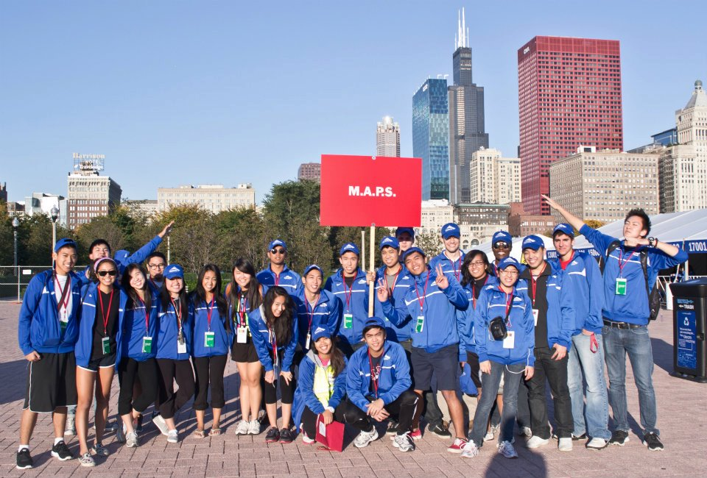
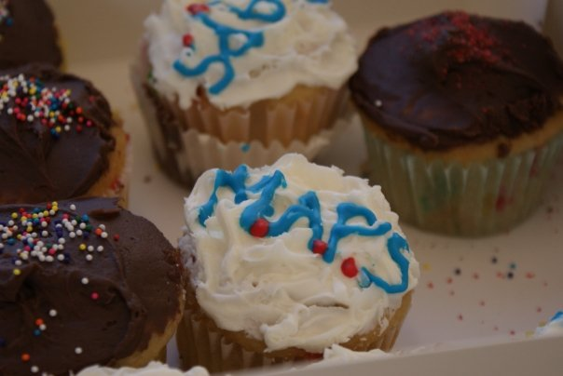
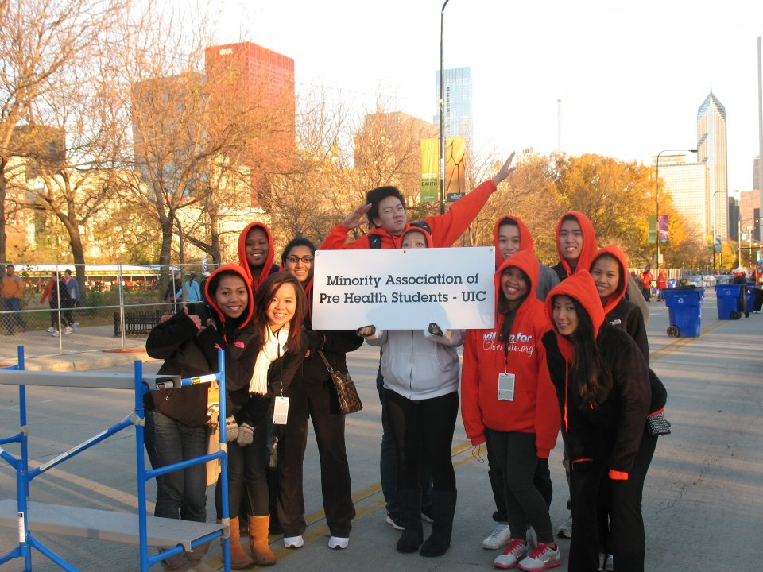
Thank You For Coming!
See you at the next meeting! Sorry we all couldn’t be there!

